Slide 1
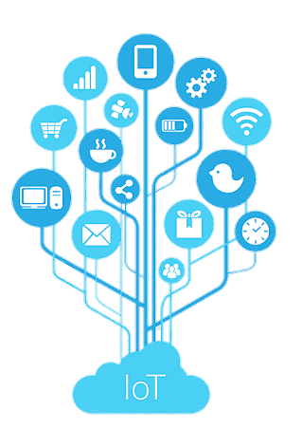

Risk Analysis and Support System for Children with ASD Using IoT
Presented by
Susmita Debnath
191002076
Tahiya Akter
191002213
Shartaz Yeasar Feeham
191002130
Supervised by
Md. Solaiman Mia
Assistant Professor
Department of CSE
Green University of Bangladesh

Slide 2
Introduction
Tools and Technologies
Data Collection
Motivation
Contents
Evaluation
Objectives
Comparative Results
Literature Review
Limitations and Challenges
Problem Description
Future Work
Methodology
Conclusion

Slide 3

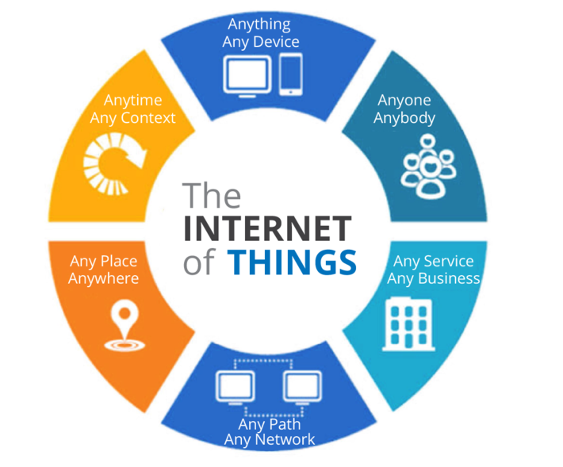
INTRODUCTION
Autism Spectrum Disorder (ASD) is a medical condition that occurs in children which affects communication and behavior of a kid.
Internet of Things (IoT) is simply a network of “things” that are connected to the internet so they can share data with each other.

Slide 4
MOTIVATIONS
Acquiring knowledge
Assuring safety
High availability of IoT
Contribute for health sector
IoT’s previous success

Slide 5
OBJECTIVES
Aims for observing and analyzing risk
To examine the extent, range, and efficiency of IoT
To make risk detection algorithms reliable
Propose a protection device model

Slide 6
PROBLEM DESCRIPTION
Autism children deserve to be observed without being treated like they are caged.
For being not observed they are getting in risk.
For being over observed they are being caged.
IoT has a big role in healthcare but not enough in this field.
The problem
Why
is it
What can not be done
What can be done
Real time monitoring
Capturing risks from surrounding environment or movements
Limited range.
Can catch up certain situations only.

Slide 7
LITERATURE REVIEW
Here are some review on works that have been conducted on the similar field -
Title | Brief | Pros | Cons
Autism Support System using RFID Technology [1] | Identifies the location of ASD child and informs parents using RFID. | Common technology, low cost, available tools. | Backdated GSM, low range, RFID can only detect physical scenarios.
A support system for autistic children using Internet of Things technology [2] | Uses advanced computing device and multiple sensors to observe the children and acknowledge parents. | WIFI for communication, Several risk detection, calming section. | Complex implementation, large device, internet dependency.

Slide 8
LITERATURE REVIEW (cont.)
Title | Brief | Pros | Cons
Emotion Recognition of Autism Children Using IoT [3] | Use thermal infrared (IR) information as data to detect the facial expression of ASD child and analyze their status. | User friendly, effective in mental and social risk/problem detection, doesn’t use multiple sensors. | Some ASD child make abnormal facial expressions.
Role of IoT and ML for autistic people [4] | A comparative study about the various systems currently being used for monitoring the autistic patients’ and how can those be efficiently applied. | Polysomnography, pulse rate sensor, eye tracking glasses. | Some proposed applications are sensitive, stationary and inefficient

Slide 9
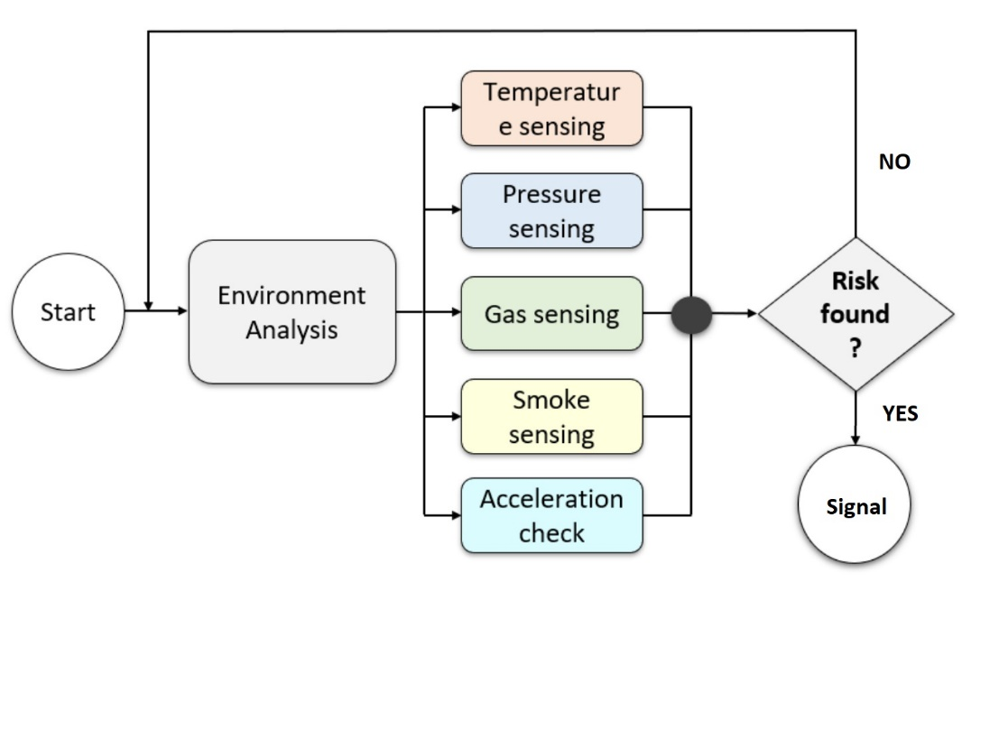
METHODOLOGY (SYSTEM FLOW AND ENGINEERING PROCESS)
Fig: Flow of the risk detection system

Slide 10
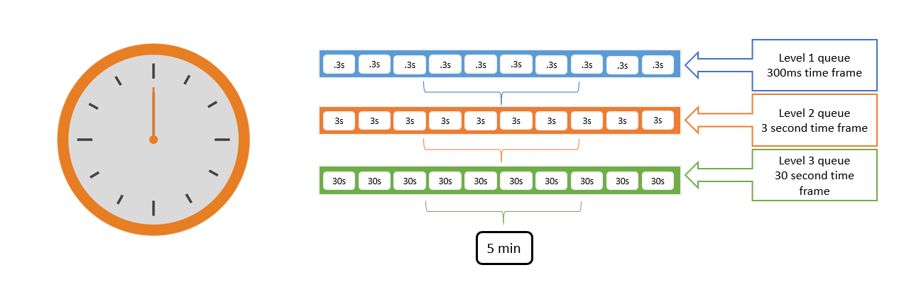
METHODOLOGY (SPACE OPTIMIZATION)
Clock-Queue: Overcoming the Storage Problem
There are 3 different queues for each of the sensor data, a single cell of a higher level queue represents a whole lower level queue by storing the average of lower level queue. Which ensures data abstraction and space optimization.
Fig: Clock queue data structure

Slide 11
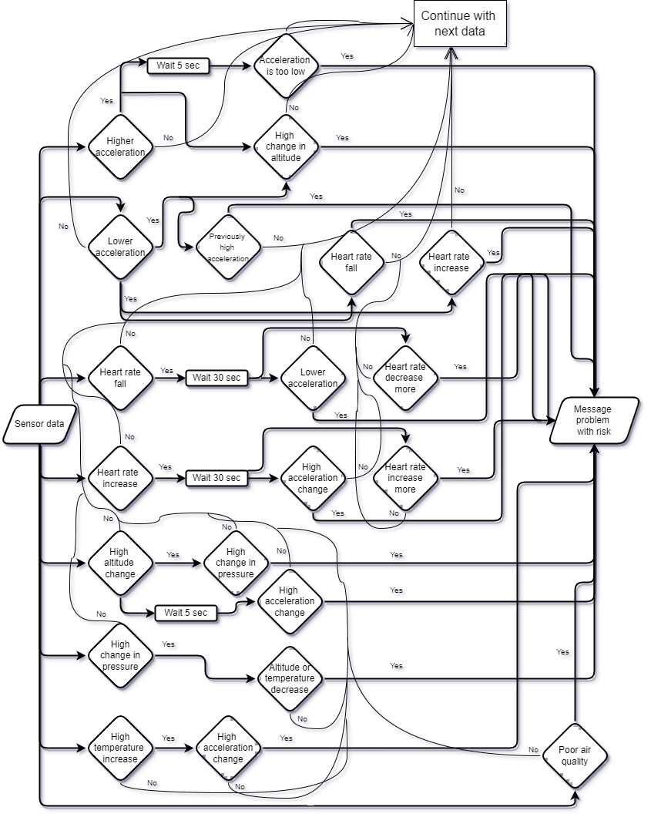
METHODOLOGY (FLOWCHART)
Fig: Flow chart of algorithms

Slide 12
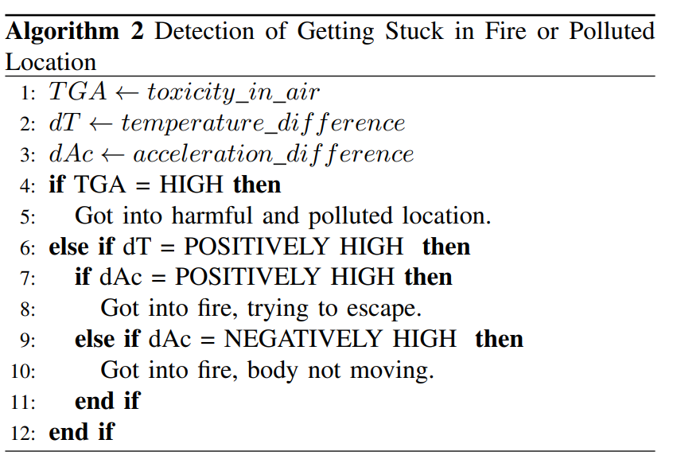
METHODOLOGY (ALGORITHMS)
The system uses the data in real-life logical conditions to determine a state. There are 5 different algorithms that handles a dozen types of input data; each one is connected with others’ yet independent. A cooperative flow shown here, is the backbone of the system.
Fig: Algorithm 2

Slide 13
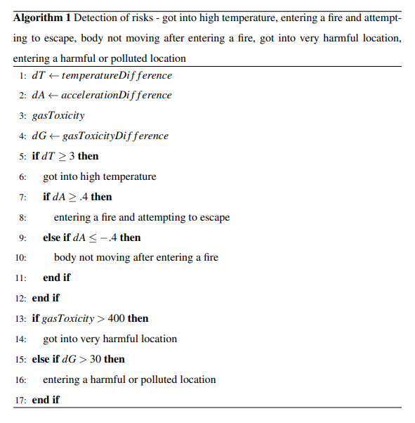
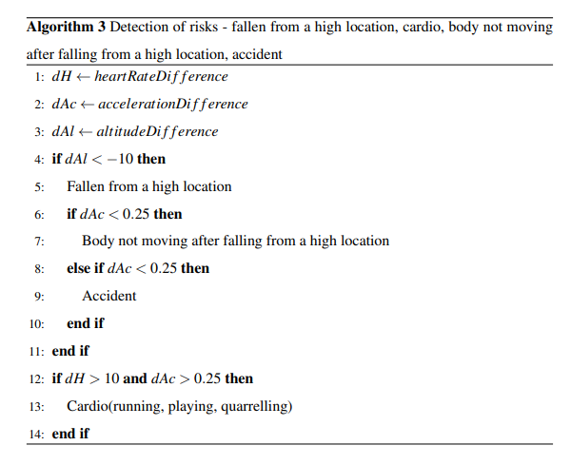
METHODOLOGY (ALGORITHMS)
Fig: Algorithm 1
Fig: Algorithm 3

Slide 14
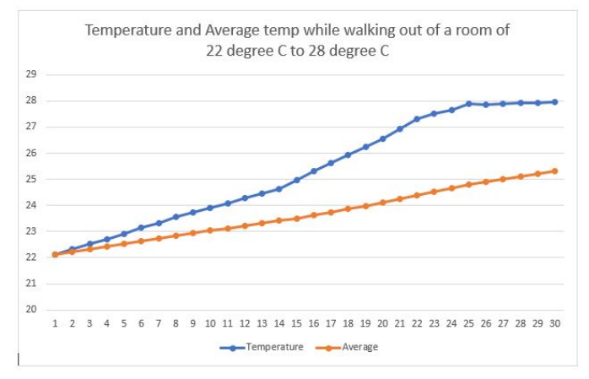
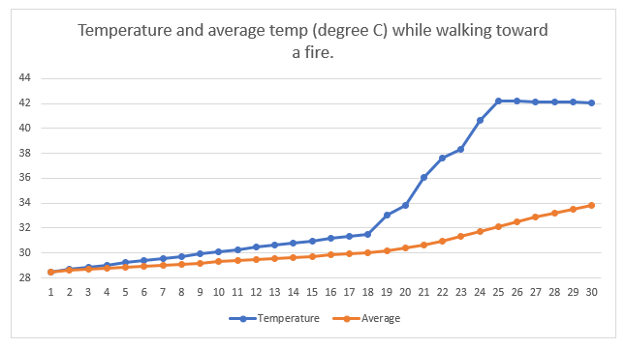
METHODOLOGY (THRESHOLDS)
To figure out different threshold values, we conducted several experiments for each of the input data. The experiments are divided into two different types.
Regular events: Experimented on regular environments and surroundings to observe what the data looks in no-risk situation.
Risky events: Experimented on risky environments and surroundings to observe what the data looks in risky situation.
Fig: Experiment results on Temperature threshold

Slide 15
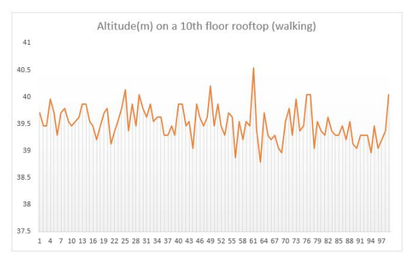
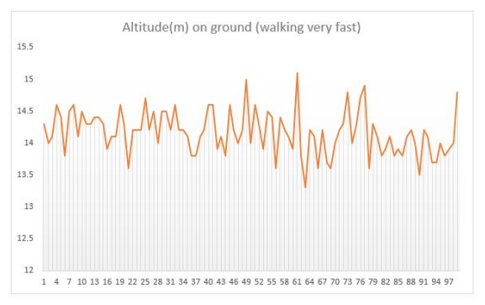
METHODOLOGY (THRESHOLDS)
Fig: Experiment results on Altitude threshold

Slide 16
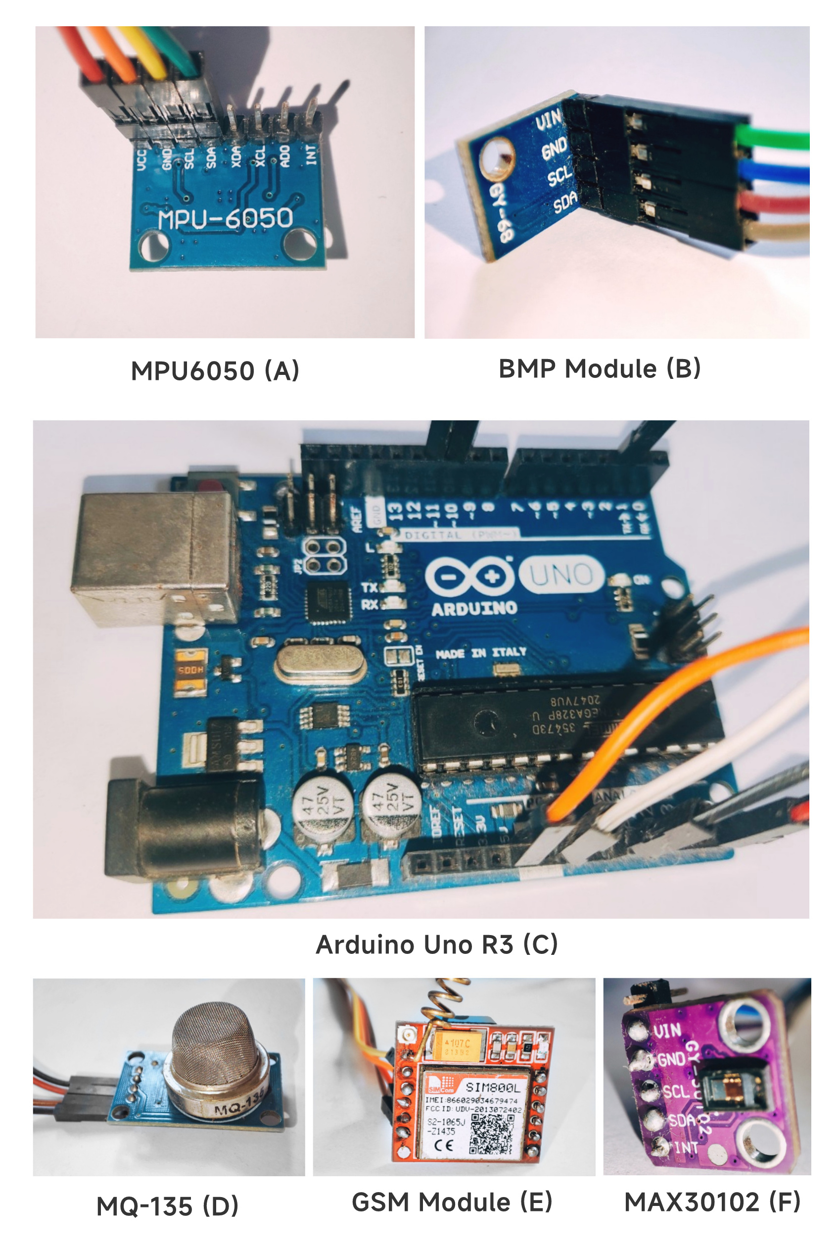
TOOLS AND TECHNOLOGIES
The proposed system consists of a processing device(Arduino Uno), a communication device (GSM module) alongside with 4 sensors, those are –
Accelerometer (MPU6050)
Gas (MQ135)
Barometric pressure(BMP-180)
Heart rate (MAX30102)
Fig: Hardware components

Slide 17
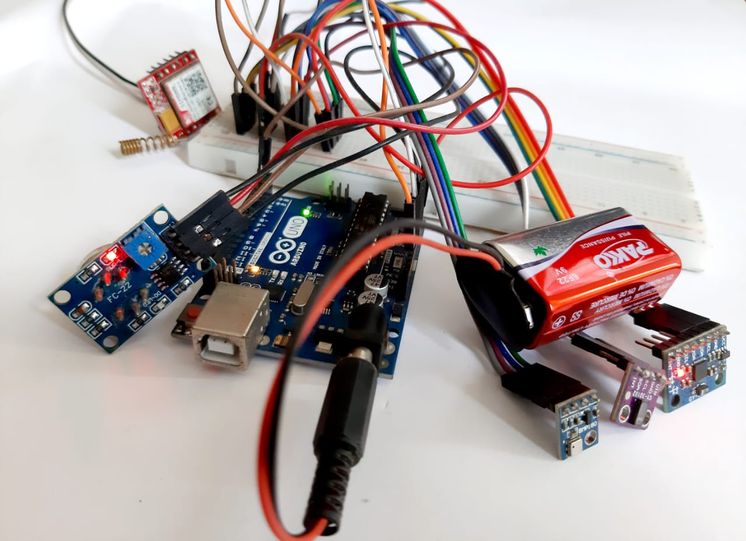
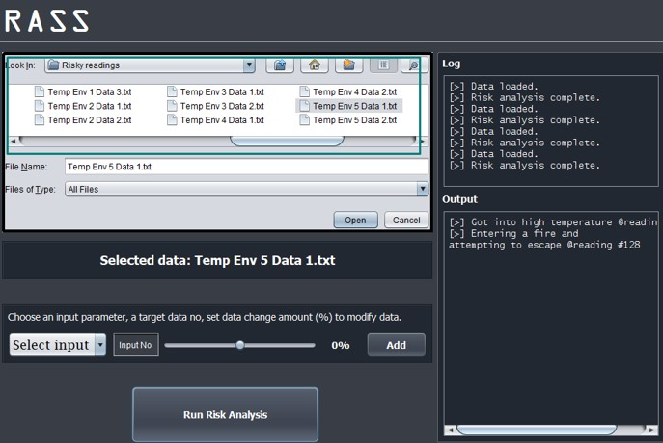
IMPLEMENTATION
The following figures shows the implementation of the work.
Fig: Hardware implementation
Fig: Software implementation

Slide 18
DATA COLLECTION
Designed prototype system relies on sensor based environmental information. Each sensor provides some certain types of real-time data.
Acceleration (3-axis), Angular rotation
Accelerometer sensor
Barometric pressure sensor
Temperature (nature), Pressure, Altitude, Humidity
Heart rate sensor
Gas sensor
Ammonia (NH3), Sulfur (S), Benzene (C6H6), CO2
Heart rate, Pulse oximeter, Temperature (body)

Slide 19
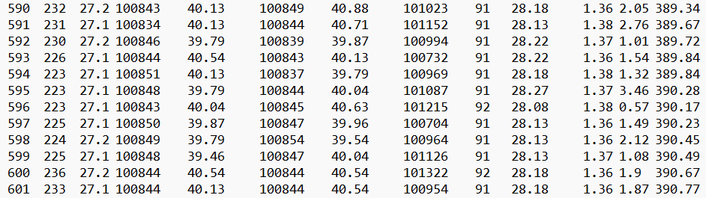
DATA COLLECTION (cont.)
The 4 different sensors read 3 data per second (300ms interval), the following snap of the data are direct input for our algorithms. The data is collected from the real world in real time.
Fig: Input data

Slide 20
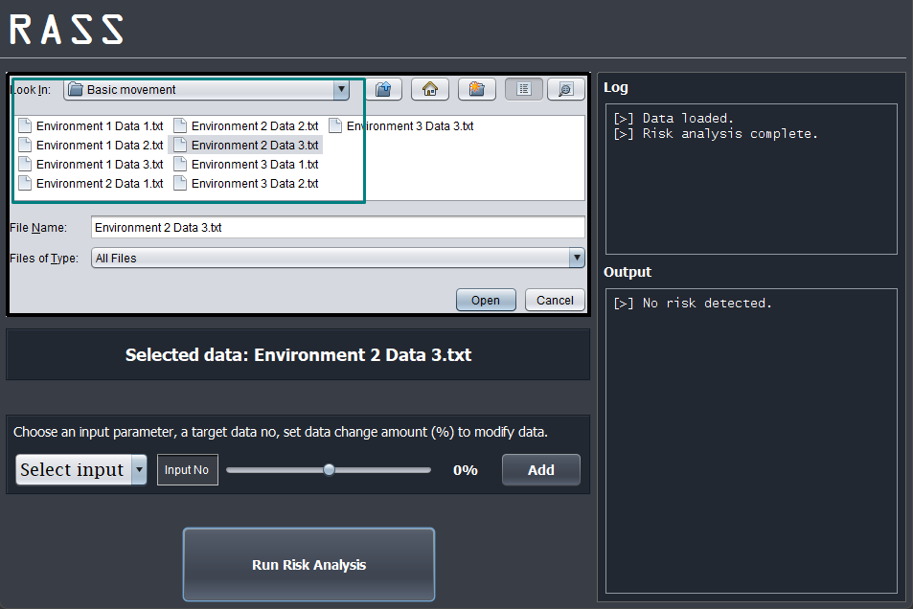
EVALUATION
The testing of the system and efficiency of algorithms are conducted in two different types. First one includes testing with no-risk data while the second one involves data that represents a risky event.
In both of the cases the algorithms could capture results pretty perfectly.
Fig: Normal event testing

Slide 21
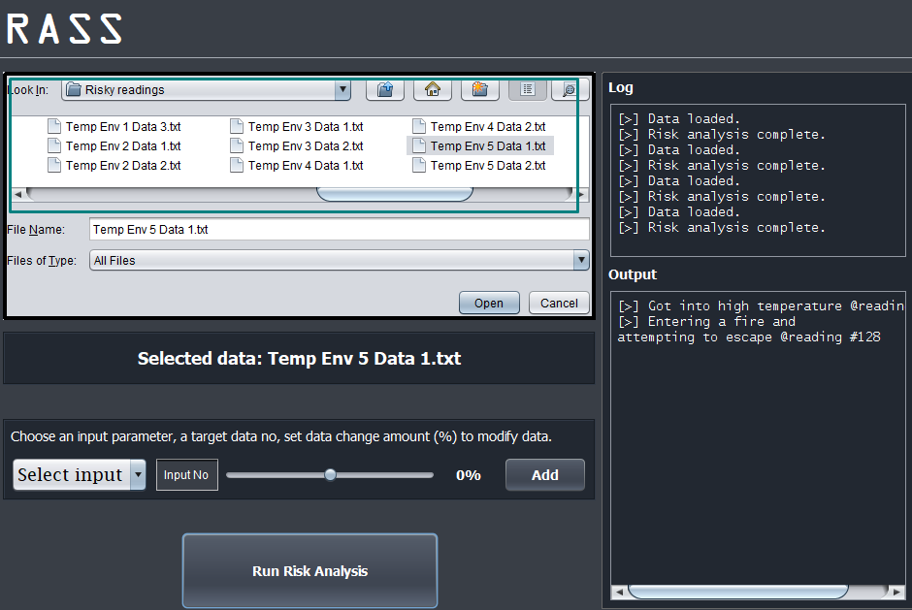
EVALUATION (cont.)
Fig: Risky event testing

Slide 22
COMPARATIVE RESULTS
Work | System Type | Physical risk detection | Mental risk detection | Differentiating regular vs risky event | Regular vs risky events differentiating performance | Embedded Risk Analysis | Dataset
[1] | Detection, Tracking | Yes; A Few | No | No | - | Arduino, RFID, GSM | Real-time Data
[2] | Detection, Analysis, Tracking | Yes; Several | Yes; Several | No | - | Yes; Particle photon, Arduino, Sensors, GSM | Real-time Data
[3] | Detection, Analysis | Yes; A Few | Yes; Several | Yes | Very Low | Yes; Arduino, IR, Camera | Real-time Data
[4] | Detection, Analysis | Yes; A Few | Yes; A few | Yes | Very Low | Yes; Arduino, IR, Camera | Real-time Data
Proposed Work | Detection, Analysis, Tracking | Yes; Many | Yes; Several | Yes | Very High | Yes; Arduino, Sensors, GSM | Real-time Data

Slide 23
LIMITATIONS AND CHALLENGES
The system works as expected till now, but further evaluation may figure out more defects.
However some drawbacks found yet are –
Differentiating risky events vs regular events.
Limited risk detection.
Testing is hard and risky.
Failure propagation.
Hart rate sensor is not capable enough.

Slide 24
FUTURE WORK
The work can be extended based on the previously mentioned limitations in future. New capability or extent that can be added to our existing research are -
Adding more risk detectability
Updating threshold with more experiments
Advance in sensor devices

Slide 25
CONCLUSION
Autistic children face many difficulties which includes life threatening risky events as well.
Their parent or a supervisor can not always keep observing the child.
Our proposed framework comes up with different risk detection for the sake of their safety and freedom.

Slide 26
REFERENCES
[1] A. S. Agnal, S. Janani, C. Maneesha and K. Ramya “Autism Support System using RFID Technology,” Int. J. Engineering and Advanced Technology, vol. 9, no. 1, pp. 4706-4710, 2019.
[2] N. M. Abdullah and A. F. A. Allaf, “A support system for autistic children using Internet of Things technology,” 2021 Int. Conf. Advanced Computer Applications (ACA), pp. 51-56, 2021.
[3] K. Lavanya, S. M. Anitha, J. Joveka, R. Priyatharshni and S. Mahipal, “Emotion recognition of autism children using IoT,” Int. J. Applied Engineering Research, vol. 14, no. 6, pp. 106-111, 2019.
[4] S. Dedgaonkar, R. K. S. Bedi, K. Kothari, R. Loya and S. Godbole,“Role of IoT and ML for autistic people,” Int. J. Future Generation Communication and Networking, vol. 13, no. 3, pp. 773–781, 2019.

Slide 27
Accepted Paper from this Thesis
[1] S. Debnath, T. Akter, S. Y. Feeham and M. S. Mia, “Risk Analysis and Support System for Children with ASD Using IoT” International Conference on Sustainable Technologies for Industry 4.0, 2022.

Slide 28
THANK YOU

